Slide 1
Chapter 9 – Securing Windows IIS

Slide 2
Web Server (IIS)
Role of Web Server (IIS)
  Handle http requests
  Application reliability
  Security – check credentials
  Log activity

Slide 3
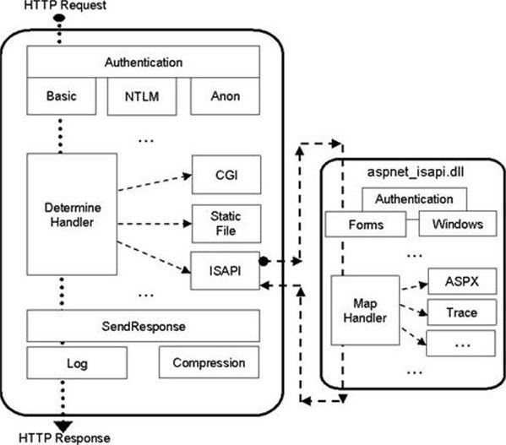
Handle Requests

Slide 4
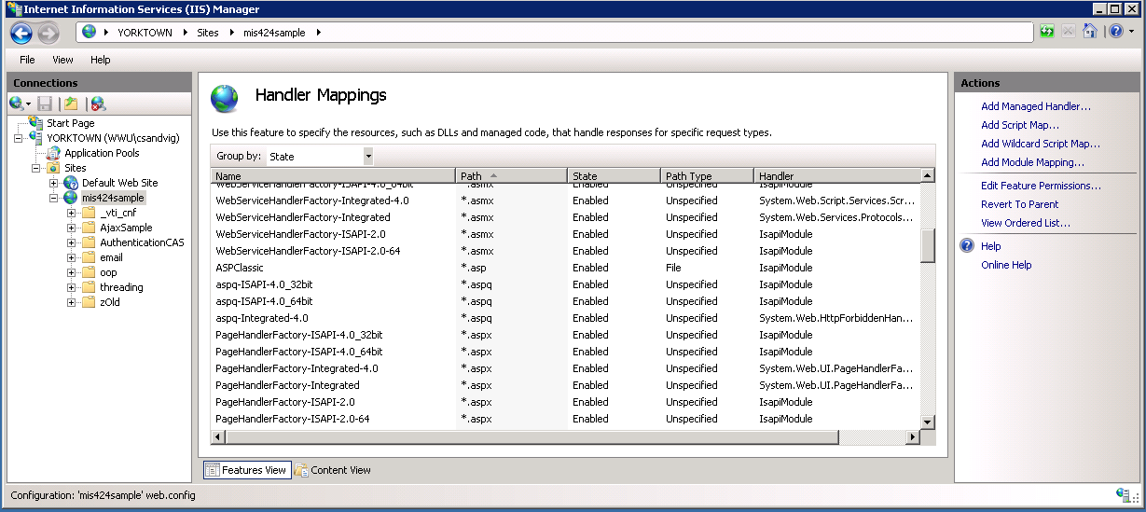
Handle Requests
Application transfers request
to appropriate handler

Slide 5
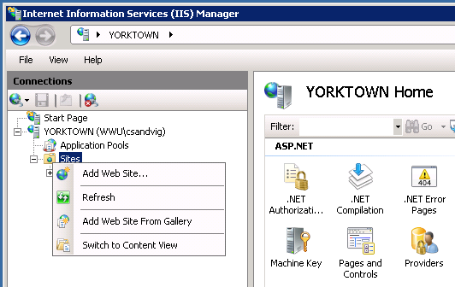
Set up web sites
IIS Manager
  GUI to manage web site configuration
  Host multiple web sites on single server

Slide 6
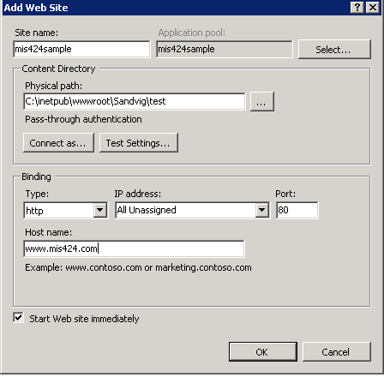
Set up new web site

Slide 7
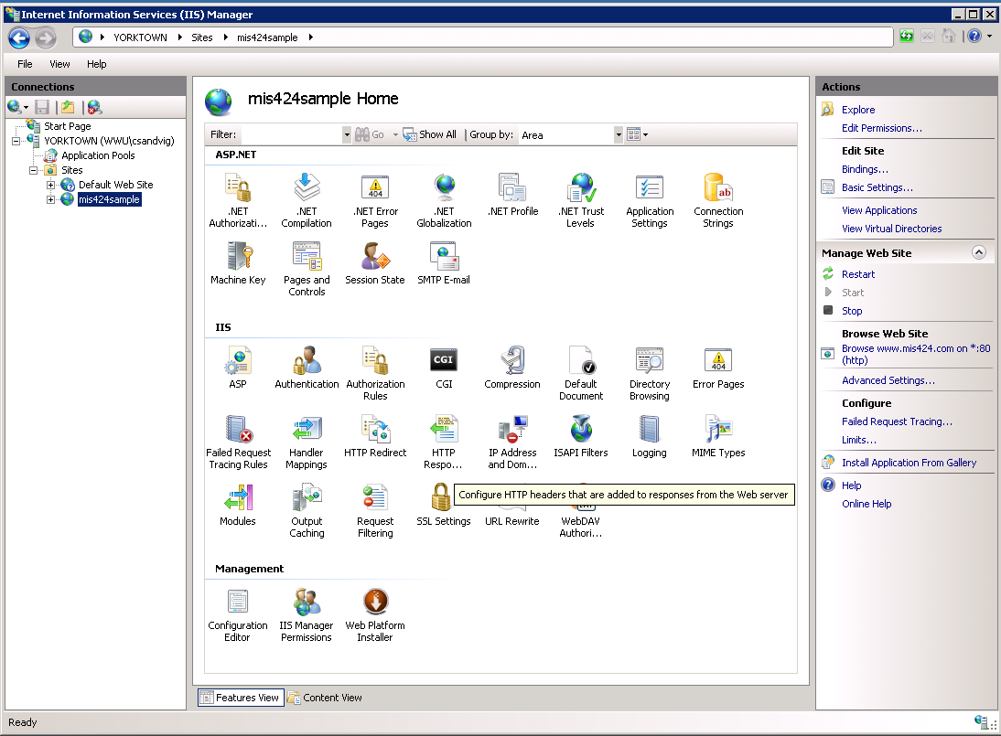
Set up web site
Each web site
has many
configuration
options
Goals:
  Reliability
  Security

Slide 8
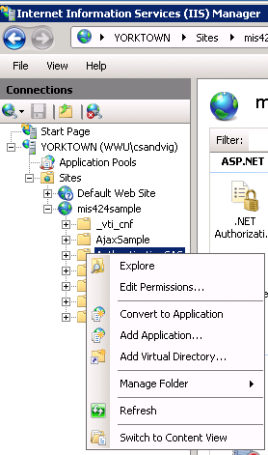
ASP.NET applications
Web sites
partitioned into
applications
Each application
has many config.
options
Goals:
  Reliability
  Security

Slide 9
Application pools
Applications can become “un-healthy”
  Memory leaks
  Errors
  Abandoned data stored in Application
  etc. etc.
Become slow
Consume lots of memory

Slide 10
Application pools
Application Pools
  Added in Server 2003
Assign applications to “pools”
  Each pool is Windows process
Create rules to:
  close unused applications
  restart unhealthy applications
  release memory

Slide 11
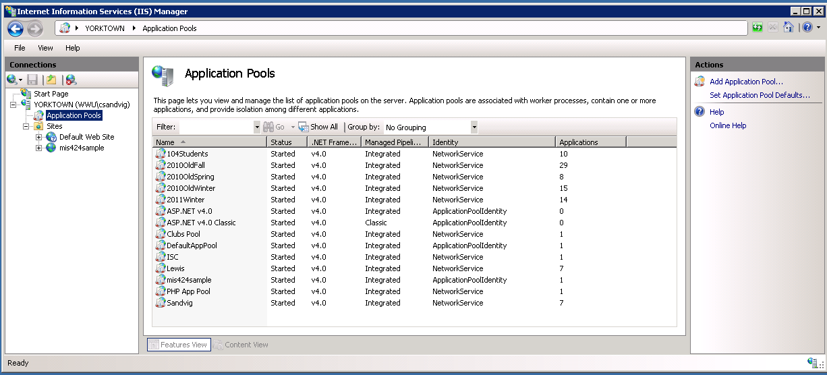
Application pools
Create new application pools in IIS

Slide 12
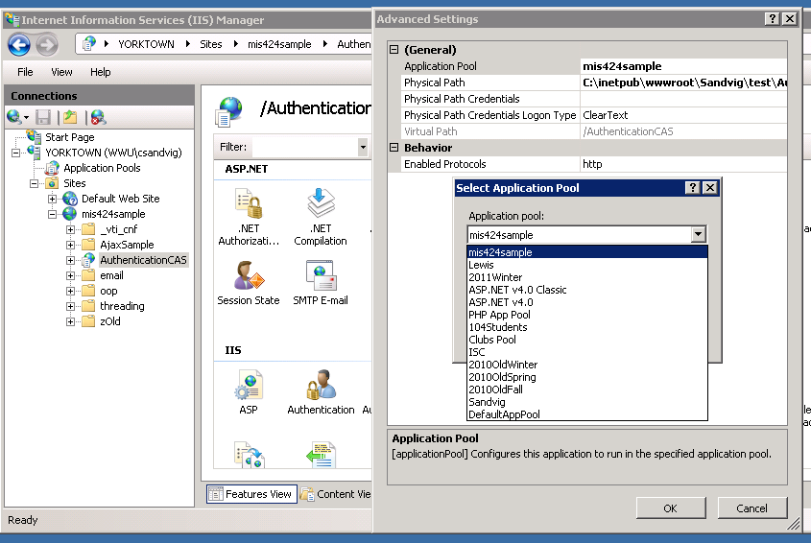
Application pools
Assign applications to pools

Slide 13
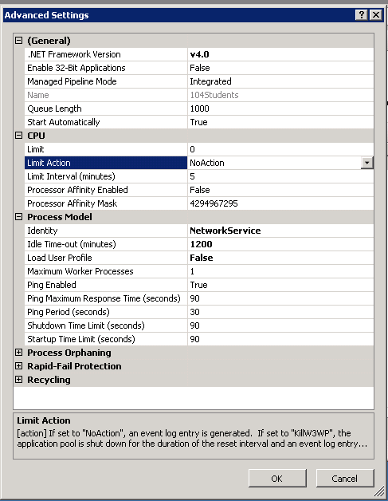
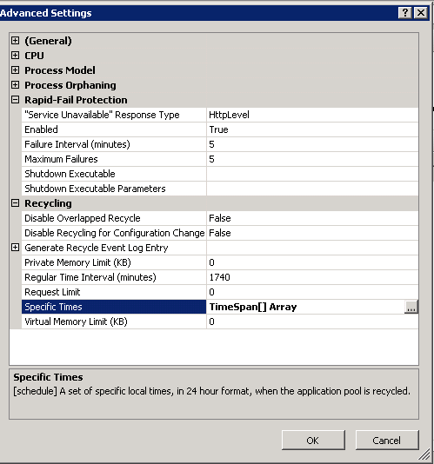
Very effective!

Slide 14
Security
Every request requires authentication and authorization
Anonymous users
Permissions from IIS
  Network Service account
    Built-in Windows account

Slide 15
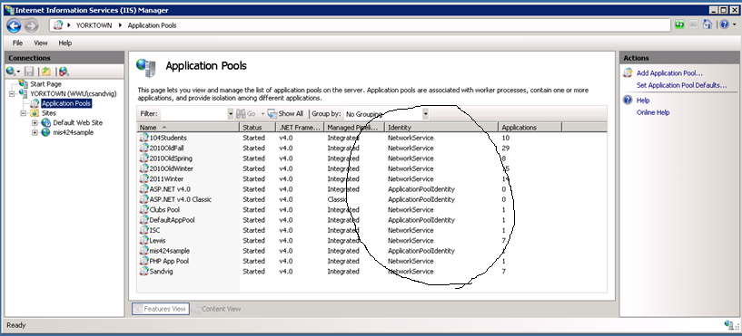
IIS Security
Assigning identities to requests

Slide 16
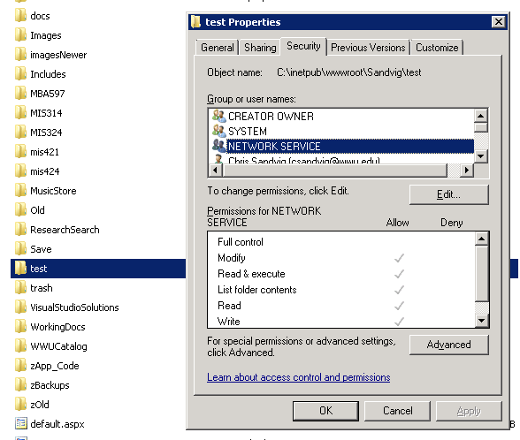
IIS Security
Windows permissions on folder

Slide 17
Best Practices for Website Folders
Physical folder structure
/root – starting point of the website
Home page
/scr – stores scripts
-Don’t call it “scripts” as this is a tip -off for hackers
/exe – executables
-Don’t call it “bin” or “cgi-bin” as this is a tip-off for hackers; may not even want to call it “exe”
images – graphics
-Reduces clutter in other folders and can be removed from logging

Slide 18
Secure Sockets Layer (SSL)
A digital certificate issued by a certification authority (CA) identifies an organization
The public key infrastructure (PKI) defines the system of CAs and certificates
Public key cryptography depends on two keys
  A public key is shared with everyone
  The public key can be used to encrypt data
  Only the owner of the public key has the corresponding private key which is needed to decrypt the data

Slide 19
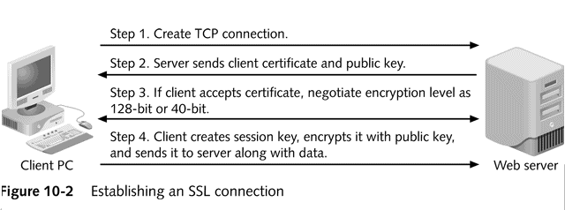
Establishing an SSL Connection

Slide 20
Vulnerabilities in Web servers
Static HTML pages pose virtually no problem
Programming environments and databases add complexity that a hacker can exploit
Programmers often do not have time to focus on security

Slide 21
Securing the Web Server
Enable the minimum features
  If you don't need a programming language, do not enable it
Make sure programmers understand security issues
Implement SSL where appropriate

Slide 22
Securing the Web Server-
IIS
The URLScan utility blocks potentially harmful page requests
The IIS Lockdown utility has templates to ensure that you only enable what you need
Change NTFS permissions in \inetpub\wwwroot from Everyone Full Control to Everyone Execute
Delete extensions you do not use, such as .htr, .idc, .stm, and others

Slide 23
Authenticating Web Users
Both Apache and IIS use HTTP to enable authentication
  HTTP tries to access a protected directory and fails
  Then it requests authentication from the user in a dialog box
  Accesses directory with user information
Used in conjunction with SSL

Slide 24
Top 10 Actions to Secure IIS
Harden the operating system and apply all relevant security updates
Remove unnecessary components
Configure URLScan
Place content on a separate NTFS partition
Protect files by using minimal permissions
Require encryption for sensitive Web traffic
Do not enable both the Execute and Write permissions on the same Web site
Run applications using Medium or High application protection
Use LPA for App Pool Account
Use IPSec filtering to allow only required traffic (HTTP and HTTPS) to the Web server
Notes:
Run the IIS Lockdown Tool

